Slide 1
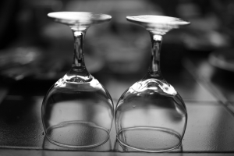
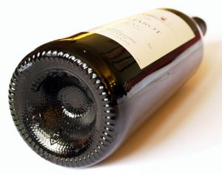
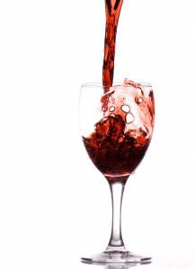
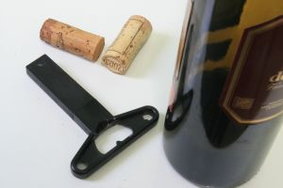
SERVE A RANGE OF WINE PRODUCTS
D1.HBS.CL5.15
Notes:
Trainer welcomes students to class.

Slide 2
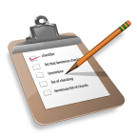
Subject Elements
This unit comprises six Elements:
Develop wine knowledge
Store and retrieve wines
Undertake sensory appraisal of wines
Provide advice to patrons
Serve wines
Maintain wine knowledge
Notes:
Trainer advises this Unit comprises six Elements, as listed on the slide explaining:
• Each Element comprises a number of Performance Criteria which will be identified throughout the class and explained in detail
• Trainees can obtain more detail from their Trainee Manual
• At times the course presents advice and information about various protocols but where their workplace requirements differ to what is presented, the workplace practices and standards, as well as policies and procedures must be observed.

Slide 3

Assessment
Assessment for this unit may include:
Oral questions
Written questions
Work projects
Workplace observation of practical skills
Practical exercises
Formal report from supervisor
Notes:
Trainer advises that assessment for this Unit may take several forms all of which are aimed at verifying they have achieved competency for the Unit as required.
Trainer indicates the methods of assessment that will be applied to them for this Unit.

Slide 4
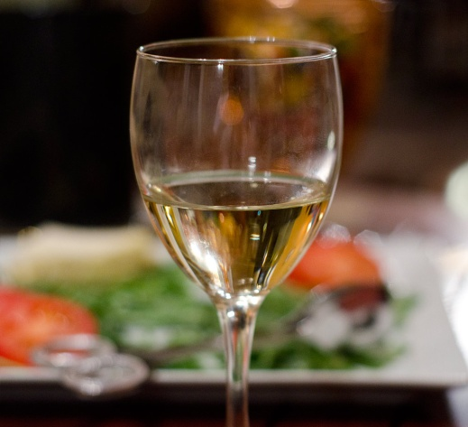
Element 1:
Develop wine knowledge
Notes:
Introduce topic.
Class Activity – General Discussion
Ask general questions:
What is wine?
What wines do you know?

Slide 5
Develop wine knowledge
Performance Criteria for this Element are:
Identify and differentiate between wine styles
Identify and differentiate between the major grape varieties used in wine production
Identify major wine producing countries and the wines they produce
Notes:
Trainer identifies the Performance Criteria for this Element, as listed on the slide.

Slide 6
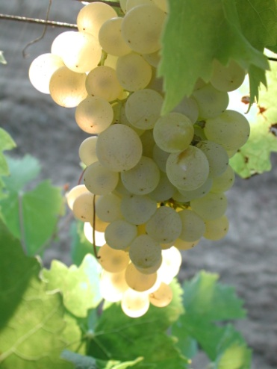
Develop wine knowledge
Performance Criteria for this Element are:
Identify the steps in basic wine production
Describe variations in grape growing and wine production techniques
Interpret wine labels to identify and make assessment of wine contained within bottles
Notes:
Trainer identifies the Performance Criteria for this Element, as listed on the slide.

Slide 7
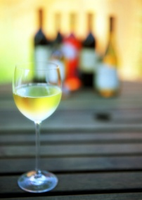
Develop wine knowledge
Wine
Wine is defined as the naturally produced beverage made from the fermented juice of grapes
Wine is a major aspect of beverage service and is routinely served to complement a lunch or evening meal
Notes:
Class Activity – General Discussion
Discuss the different types of wine
This is just to get ideas as it will be explained in more detail.

Slide 8
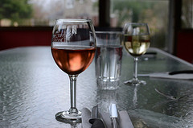
Develop wine knowledge
Wine styles
Varietal or generic table wines
Sparkling wine
Fortified wine
Rice wine
Notes:
Questions
What is the difference between varietal and generic wines?
What is the difference between these?

Slide 9
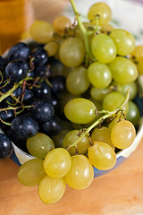
Varietal wines
‘Varietal’ wines are wines made from one grape variety
The name of this grape appears on the label of the bottle
The wine must be made from a minimum 85% of that stated variety
Notes:
Questions
What types of varietal wines do you know?
Which are white wines?
Which are red wines?

Slide 10
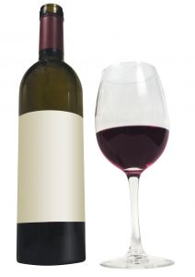
Generic wines
‘Generic’ is the term used to describe wines are made to a style, usually naming a European location as its origin.
What generic wines do you know?
Notes:
Questions
Discuss the question in the slide.

Slide 11

Generic wines
Generic white wines
Generic white wines include:
Chablis
Hock
Moselle
Sauternes
White Burgundy
Notes:
Questions & Discussion
What taste characteristics do each of these generic wines have?
Chablis – a very dry, flinty wine
Hock – a very dry white wine
Moselle – a popular and pleasantly semi-sweet wine, less sweet than Sauternes
Riesling – drier than Moselle. Often described as fruity and has its fruitiness confused with sweetness
Sauternes – produced from fully ripe grapes, a very sweet wine
White Burgundy – a fairly dry white with full flavour.

Slide 12
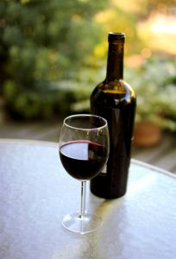
Generic wines
Generic red wines
Generic red wines include:
Burgundy
Claret
Notes:
Questions & Discussion
What taste characteristics do each of these generic wines have?
Burgundy – a soft and fruity red wine
Claret – a dry red with more astringency than burgundy.

Slide 13
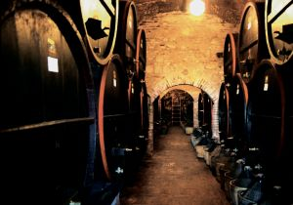
Varietal and generic wines
When most wine industries started, most if not all of its wines were generic wines.
Today there is a tendency for:
Cask or house wines to be generic
Premium bottled wines to be varietal
Notes:
Review menu, questions and wine selection
Audience to review detailed wine menus identifying different types of varietal and generic wines.
What wines are house wines and why?
If you were preparing a menu based on the food menu what wines would you select and why?
What are other characteristics of house wine?

Slide 14

Champagne / sparking wines
The word ‘Champagne’ is now legally reserved for sparkling wine produced from the Champagne region in France
Where produced in other parts of the world, it is correctly now known as ‘sparkling wine’
Notes:
Discussion
What other differences exist between these wines? (Production etc)

Slide 15
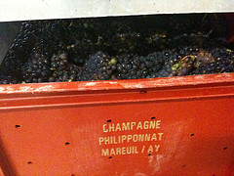
Champagne / sparking wines
Styles
Non-vintage (N.V.)
Vintage
Rosé
Crémant
Blanc de blancs
Blanc de Noirs
Notes:
Discuss the styles of champagne.

Slide 16
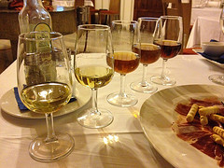
Fortified wines
Fortified wines are base wines which are strengthened or ‘fortified’ by the addition of grape spirit or brandy.
The addition of the grape spirit:
Stops fermentation
Increases alcoholic strength
Adds sweetness
Imparts keeping qualities
Provides the brandy character
Notes:
Questions
What types of fortified wines are there?
When are they commonly served?
What are they served with?

Slide 17
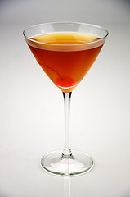
Fortified wines
Types of fortified wines
Sherry
Vermouth
Port
Muscat
Tokay
Madeira
Notes:
Questions
What is the difference between these types of fortified wines?

Slide 18
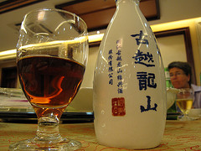
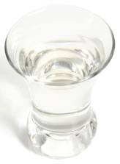
Rice wines
Rice wine is an alcoholic beverage made from rice
Rice wine typically has a higher alcohol content
Rice wine is much used in Chinese cuisine and in other Asian cuisines
Notes:
Questions
What types of rice wine exist?
What different types do they have in different countries?

Slide 19
Identify and differentiate between the major grape varieties
Grapes
The most significant influence on the character of a wine is the actual berry or grape variety used.
Grape variety refers to the type of grape
Varietal refers to the wine made from those grapes
Notes:
Questions
What types of grapes are used?

Slide 20
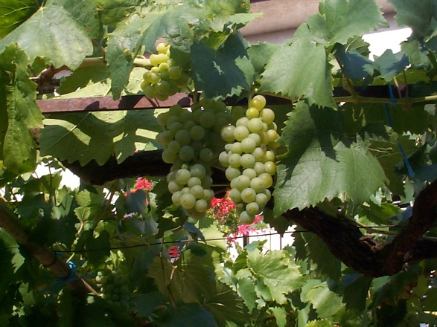
Identify and differentiate between the major grape varieties
Grapes
The structure of the grape berry can be broken down into three major components:
Flesh containing juice
Skin
Seeds
Notes:
Questions
How do these components impact a wine?

Slide 21
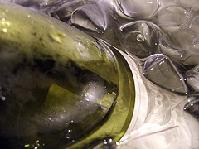
Varietal wines
Varietal white wines
White grape varieties include:
Chardonnay
Chenin Blanc
Riesling
Sauvignon Blanc
Semillon
Traminer
Notes:
Questions & Discussion
What taste characteristics do each of these varietal wines have?
Chardonnay – a full-flavoured dry white wine
Chenin Blanc – a pleasant fruity ‘drink now’ wine with a refreshing acid finish
Rhine Riesling – a delicate wine with fruit character and a trace of sugar that varies hugely depending on the region in which it is grown. Common flavour asparagus
Sauvignon Blanc – a dry white wine with distinct varietal flavour such as melon, pineapple, tropical fruit
Semillon – a dry, crisp white wine with grassy flavours
Traminer – a fresh and fruity wine with a spicy smell and taste.

Slide 22
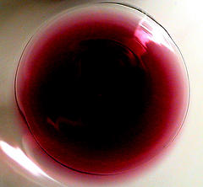
Varietal wines
Varietal red wines
Red grape varieties include:
Cabernet Sauvignon
Malbec
Merlot
Pinot Noir
Shiraz
Notes:
Questions & Discussion
What taste characteristics do each of these varietal wines have?
Cabernet Sauvignon – an aromatic red with berry, mint, capsicum and blackcurrant highlights
Malbec – a fruity, soft wine
Merlot – another fruity and aromatic red reminiscent of plums, pumpkins and fruitcake
Pinot Noir – a lighter style red, thin in taste and colour, berry flavours
Shiraz – also called ‘Hermitage’ this grape produces fine full-flavoured reds that vary greatly from region to region. They are often blended and have peppery characteristics

Slide 23
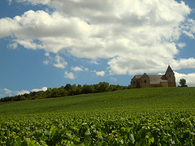
Wine growing countries
What are famous wine growing countries?
Notes:
Questions
Answer the question in the slide to generate discussion.
The wine producing countries and regions will be discussed in more detail.

Slide 24
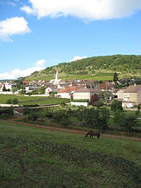
Wine growing countries
Top 10 wine producing countries in 2011
1-5
France
Italy
Spain
United States
Argentina
Notes:
Questions
What characteristics makes these countries suitable to grow grapes for wine production?
What types of varietals come from these countries?

Slide 25
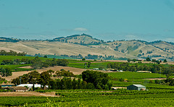
Wine growing countries
Top 10 wine producing countries in 2011
6 - 10
China
Australia
South Africa
Germany
Portugal
Notes:
Questions
What characteristics makes these countries suitable to grow grapes for wine production?
What types of varietals come from these countries?

Slide 26
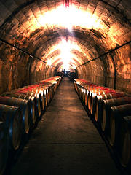
Wine growing regions
Wine growing regions
This section will explore some of the most famous regions for producing wine around the world
Given that most wines on an international wine list will feature wines from these regions, having a basic understanding of these is helpful
Notes:
Questions & Review wine lists
What famous wine regions do you know?
What wines are produced in these regions?
Trainer to get a variety of wine lists so that they can identify different countries, regions and varietals of wine, commonly found on international wine lists

Slide 27
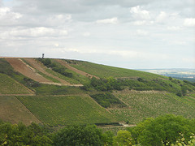
Wine growing regions
France
Champagne
Burgundy (Bourgogne)
Bordeaux
Loire Valley
Alsace
Notes:
Discuss these regions and wine varietals produced.

Slide 28
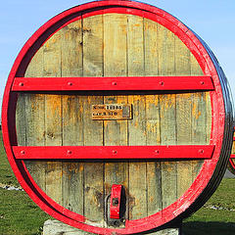
Wine growing regions
Italy
Tuscany
Veneto
Albana di Romagna
Notes:
Discuss these regions and wine varietals produced.

Slide 29
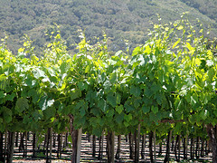
Wine growing regions
United States of America
Napa Valley
Sonoma
Washington State
Notes:
Discuss these regions and wine varietals produced.

Slide 30
Wine growing regions
Australia
Hunter Valley
Barossa Valley
Yarra Valley
Margaret River
Notes:
Discuss these regions and wine varietals produced.

Slide 31
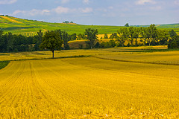
Wine growing regions
Germany
Rheinhessen
Rheingau
South Africa
Cape Winelands
New Zealand
Marlborough
Notes:
Discuss these regions and wine varietals produced.

Slide 32
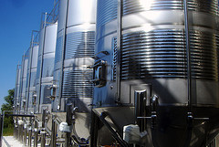
Production of wine
Whilst it is not essential it is often worthwhile to understand the wine making process.
How is wine made?
Notes:
Class Activity – Questions
Ask question in slide.

Slide 33
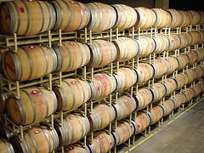
Production of wine
Basic wine production process
Selecting and collecting grapes
Fermentation
‘Cleaning’ wine
Maturing and Bottling
Notes:
Class Activity – Discuss the wine making process

Slide 34
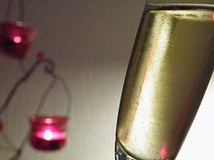
Champagne / sparking wines
Production of sparkling wine
Sparkling wines may be made using one of four options:
Naturally carbonated wine
Carbonated or Injection method
Cuvee close, Charmat, Bulk or Tank method
Transfer method
Notes:
Discuss the sparkling wine making process including the difference between these four methods.

Slide 35
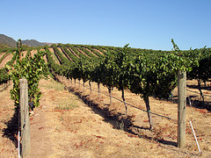
Variations in wine production
Impacts on wine production
Whilst there are quite general styles and varietals of wine, it is not expected that all producers follow the same rules when making them.
What impacts wine production?
Notes:
Discussion
Discuss possible impacts on wine production.

Slide 36
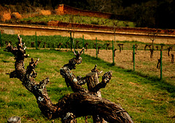
Impacts on wine production
The vine itself
Climate
Soil
Canopy – leaf to fruit ratio
Growth cycle
Site selection
Age of vines and orientation
Notes:
Discussion
Discuss how these impact on wine production.

Slide 37
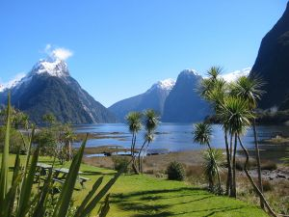
Impacts on wine production
Climate
Temperature
Sunshine
Evaporation
Rainfall
Wind
Notes:
Discussion
Discuss how these climatic impacts affect wine production.

Slide 38
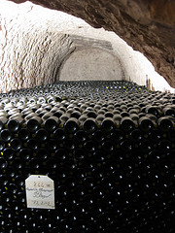
Impacts on wine production
Different wine production methods
Maceration
Cold fermentation
Barrel fermentation
Use of oak
Ageing
Notes:
Discussion about winemaking influences
Maceration - To macerate is to soften by soaking, and maceration is the process by which the red wine receives its red colour
Cold fermentation – used to help control temperatures, especially in hot climates, during the fermentation process
Barrel fermentation - Barrel fermentation is the process of letting grape juice sit in a large wooden barrel (usually oak), during which time yeast turns the sugar in the grapes into alcohol and the juice is converted into wine
Use of oak – adds flavour, smoothness and vanilla, buttery characteristics in wine. This is achieved through contact with oak either in barrels or in ‘chips or shavings’
Ageing – wine is left to mature leading to smoother, deeper and more complex characteristics.

Slide 39
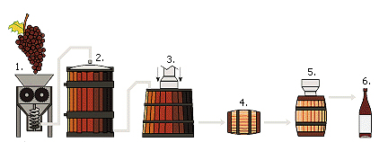
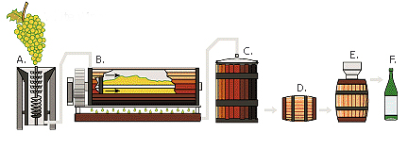
Impacts on wine production
Different wine production methods
Malo-lactic fermentation
Reduced alcohol wines
Various viticulture techniques
Alternative methods for the production of sparkling wines
Notes:
Discussion about winemaking influences
Malo-lactic fermentation – a process which tends to create a rounder, fuller feel in the mouth when drinking
Reduced alcohol wines – an alternative to attract different market segments
Various viticulture techniques
Alternative methods for the production of sparkling wines, including - Méthode Champenoise, transfer method, bulk method, injection method. These have been mentioned in the previous section.

Slide 40
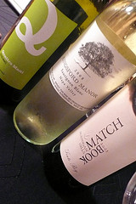
Interpret wine labels
Information on labels
The easiest way to gain an immediate understanding about a wine is to simply pick up and look at the bottle.
What information is displayed on a bottle label?
Notes:
Demonstration
Trainer to hand out bottles to audience and get them to explain what information is contained on the bottle label.

Slide 41
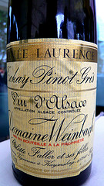
Interpret wine labels
Information on labels
Vineyard
Grape variety
Region
Country
Vintage
Alcohol content
Notes:
Discuss information contained on label
Vineyard – name of the wine producer. This indicates expected wine quality and guarantee of consistency.
Grape variety - tells you the most about the body and complexity of the wine. For example, Cabernet Sauvignon is full-bodied, intense, and tannic. As mentioned, the characteristics of different grape varieties will be explained later in this manual.
Region – where the wine was produced. It helps to identify the expected style, intensity, and flavour.
Country – again, notes where the wine has been produced
Vintage - or the year the wine is produced. This helps to reveal the best time to drink the wine.
Alcohol content

Slide 42
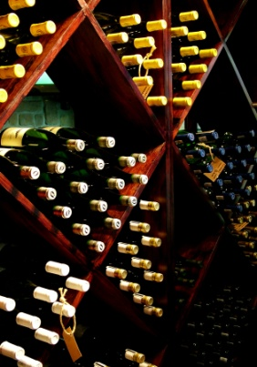
Element 2:
Store and retrieve wines
Notes:
Introduce topic.
Class Activity – General Discussion
Ask general questions:
Where is wine normally stored?
What are considerations when storing wine?

Slide 43
Store and retrieve wines
Performance Criteria for this Element are:
Develop in-house wine storage facilities
Create floor wine displays and self-service stands
Store wines in established wine storage facilities
Retrieve wines for service/sale
Notes:
Trainer identifies the Performance Criteria for this Element, as listed on the slide.

Slide 44
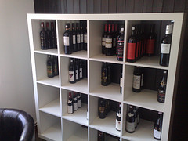
Arrange wine storage facilities
Large quantities of wine in storage
Many hospitality organisations will carry large quantities of wine at one time as most wines come in boxes containing a dozen bottles.
What are tips for storing wine?
Notes:
Discussion
Discuss the question in the slide.

Slide 45
Arrange wine storage facilities
Elements of wine storage
Quite simply wine storage facilities should include:
Storage facilities for red, white, sparkling and fortified wines
Create appropriate storage conditions for each wine classification, including suitable space, temperatures and humidity
Facilities to allow the cellaring of vintage wines for future use
Consideration of a system to store wines according to type, vintage, style, maker or country
Notes:
Discussion
Discuss the importance of these points when storing wine.

Slide 46
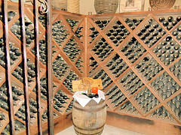
Arrange wine storage facilities
Requirements for establishing optimal storage facilities
Need for dark storage conditions
Need for a cool environment
Need for a consistent temperature
Need for a correct humidity
Notes:
Discussion
Discuss the importance of these points when developing a wine storage facility.

Slide 47
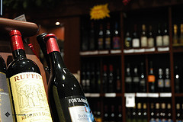
Arrange wine storage facilities
Requirements for establishing optimal storage facilities
Need for sufficient stock
Need for easy access
Need for easy identification of bottles
Need for security
Notes:
Discussion
Discuss the importance of these points when developing a wine storage facility.

Slide 48
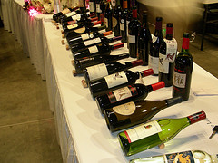
Promoting wines
In many cases, customers will not be aware of particular wines which they wish to purchase.
In these cases they will rely on a number of factors to help entice them in making a decision including:
Sales skills and promotions - provided by staff
Promotional displays themselves – provided by visual displays
Notes:
Discussion
How can you promote wines using these two methods?

Slide 49
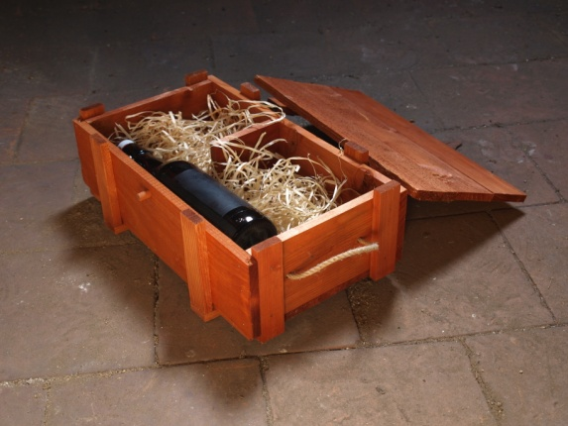
Promoting wines
General ways to promote wines
Wine displays
High-profile wine stocks
Tent cards
Racks, shelving and bins
Chalk boards
Notes:
Discussion
How are these methods beneficial?

Slide 50
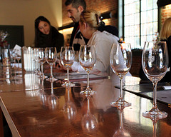
Promoting wines
General ways to promote wines
Traditional wine lists
Winemaker appearances
Tastings
‘Wine of the Week’
Personal recommendation
Notes:
Discussion
How are these methods beneficial?

Slide 51
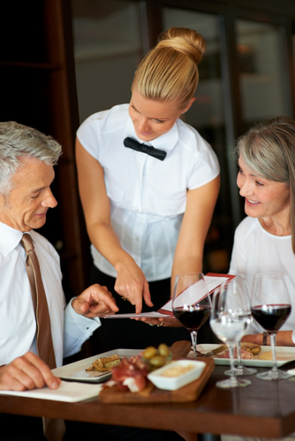
Promoting wines
Types of selling
Suggestive selling
Upselling
Features and benefits selling
Dual positive selling
Notes:
Discussion & Role Play
What is the difference between these types of selling?
Trainer to get the audience to break up in pairs and role play using each of these selling techniques.

Slide 52
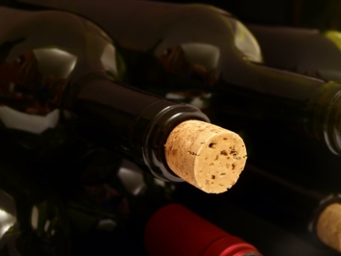
Storing wines
Wine storage techniques
Completion of necessary in-house documentation to record wine storage
Storage of red, white, sparkling and fortified wines under correct storage conditions
Ensuring the security and presentation of all products
Allow ease of access
Monitoring wine and bottle conditions during storage
Notes:
Discussion
Discuss these wine storage techniques.

Slide 53
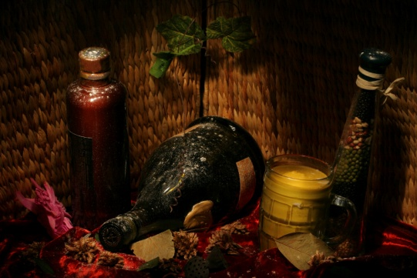
Storing wines
Monitoring wine and bottle conditions during storage
Is out of light
Unlikely to be stolen
Unlikely to be dropped or broken
Has minimal disruption and handling
Notes:
Discussion
What else can you do to monitor wine condition?
Who should be in charge of this?
How often should it be done?

Slide 54

Retrieve wines
Retrieving wines
Completion of necessary in-house documentation to track stock movement of wine
Ensuring bottles are stored in either bin number, wine list order, by region or alphabetically to ensure easier identification
Verifying the condition of wines
Minimal movement and handling
Notes:
Discussion
Why are these points important?

Slide 55

Retrieve wines
Correct serving temperatures of wine
Blush, rose and dry white wines - 8 to14ºC
Sparkling wines and champagne - 6 to 8ºC
Light red wine - 13ºC
Deep red wines - 15-19ºC
Notes:
Discussion
How can you get wines to these temperatures?

Slide 56

Element 3:
Undertake sensory appraisal of wines
Notes:
Introduce topic.
Class Activity – General Discussion
Ask general questions:
What are good ways to appraise wines?
What happens during a wine tasting?

Slide 57
Undertake sensory appraisal of wines
Performance Criteria for this Element are:
Create the conditions for wine tasting and appraisal
Evaluate wines by sight, taste and smell
Identify wines by style and grape variety
Determine wine quality and characteristics
Identify wine faults
Notes:
Trainer identifies the Performance Criteria for this Element, as listed on the slide.

Slide 58
Create the conditions for wine tasting
Undertake wine tasting
One of the best ways to be able to get a first hand understanding of wine is to undertake a wine tasting activity.
Notes:
Questions
Have you undertaken a wine tasting before?
Why are they helpful?

Slide 59
Create the conditions for wine tasting
Creating favourable conditions
Use same location
Same time of day
Use same glasses as used by customers
Follow SOPs
Notes:
Questions
Why do you do this?
What else can you do to create favourable conditions?

Slide 60

Create the conditions for wine tasting
Get wines to correct tasting temperatures
‘Optimal’ temperatures for the evaluation of wines:
Whites – 10ºC - 12ºC
Reds – around 16ºC
Fortified wines – 14ºC - 18ºC
Notes:
Questions
These are warmer than serving temperatures when customers order a wine. Why?

Slide 61

Create the conditions for wine tasting
Standard Operating Procedures
Persons involved
Where and when
Which wines
Specifications
Age of tasters
Taking of tasting notes
Instructions and directions from designated personnel
Notes:
Questions
Why are these SOPs important?
What other SOPs may influence wine tastings?

Slide 62


Create the conditions for wine tasting
Prepare tasting area and equipment
Notify participants
Ensure availability of wine
Prepare wines
Ensure clean equipment
Eliminate distractions
Provide water and crackers
Prepare tasting notes
Notes:
Questions
What is associated in each of these activities?

Slide 63

Evaluating wine
Evaluate wines by sight, taste and smell
Now that the wine tasting area has been set up, it is now time to evaluate the wines that make up the wine tasting
The sequence in which wines are tasted can impact on how they are evaluated
Notes:
Questions
What sequence options exist?

Slide 64

Evaluating wine
Appropriate order of tasting
Taste younger wines before older wines
Taste lighter styles before the more full-bodied ones
Taste wines with lower alcohol content before those with a higher alcohol content
Taste still wines before sparkling wines
Taste white wines before red wines
Taste dry wines before sweet wines
Notes:
Questions
Why should they be done in this order?

Slide 65

Evaluating wine
Types of tastings
Vertical tastings
Horizontal tastings
Blind tastings
Notes:
Questions
What is the difference between these types of tastings?

Slide 66

Evaluating wine
Undertake wine tasting
The appreciation of wine can be broken down into three different senses:
Sight
Smell
Taste
Notes:
Questions
What is the difference?
Why are each important?

Slide 67
Evaluating wine
Sight
The eyes are used to determine:
Intensity and type of colour of the wine
Clarity of the wine
The ‘legs’ of the wine
Notes:
Discuss the wine tasting process and conduct a wine tasting if possible.

Slide 68

Evaluating wine
Smell
Your sense of smell should be used in wine evaluation to look for:
Aroma
Bouquet
‘Off’ odours
Notes:
Discuss the wine tasting process and conduct a wine tasting if possible.

Slide 69

Evaluating wine
Taste
The flavours of the wine and their intensity, harmony and balance
Acidity and sweetness
The in-mouth feel or body of the wine
The level and balance of fruit, wood, alcohol, tannin and other characteristics
How the wine feels in the mouth, tongue and back of the throat
Length, finish and aftertaste of the wine
Notes:
Discuss the wine tasting process and conduct a wine tasting if possible.

Slide 70

Evaluating wine
Tasting procedures
Looking at the wine
Nosing the wine
Tasting the wine
Recording impressions
Refreshing the palate
Notes:
Discuss the wine tasting process and conduct a wine tasting if possible.

Slide 71

Discuss wine characteristics
Wine Descriptions
Most people do not have the good fortune to be able to try the wines before they are purchased and therefore they will be guided by the advice and descriptions provided by the staff
It is essential that staff are able to provide terms that help customers understand the different characteristics in reference to a wine
Notes:
Question
What are common yet simple terms that can be used to describe characteristics of wine?

Slide 72

Discuss wine characteristics
Use of wine wheels
Assists tasters to describe the wines they are drinking and tasting.
Colour wheels
Flavour wheels
Aroma wheels
Mouth-feel wheels
Food and wine matches
Notes:
Hand out and explain wine wheels
Trainer to hand out wine wheels
These will be used during the wine tasting procedure.

Slide 73
Discuss wine characteristics
Fruit flavours – White wine
GRAPE VARIETY | CHARACTERISTICS
Riesling | Pineapple
Sauvignon Blanc | Asparagus
Semillon | Grass
Chardonnay | Cucumber
Sweet/ dessert wines | Honey
Notes:
Discussion and recap of information
Discuss the common flavours of these wines?
As a recap get the audience to identify food menu items that compliment these wines.

Slide 74
Discuss wine characteristics
Fruit flavours – Red wine
GRAPE VARIETY | CHARACTERISTICS
Pinot Noir | Strawberry
Merlot | Cherry
Cabernet Sauvignon | Olive
Shiraz | Pepper
Notes:
Discussion and recap of information
Discuss the common flavours of these wines?
As a recap get the audience to identify food menu items that compliment these wines.

Slide 75
Discuss wine characteristics
Fruit flavours – Sparkling wine / champagne
GRAPE VARIETY | CHARACTERISTICS
Sparkling Wine | Apple
Champagne | Yeast
Notes:
Discussion and recap of information
Discuss the common flavours of these wines?
As a recap get the audience to identify food menu items that compliment these wines.

Slide 76

Wine characteristics
Riesling
Floral
Rose petal
Citrus
Lime
Passionfruit
Tropical fruit
Aged - Toast and honey
Notes:
Wine taste
Taste this grape varietal
Identify characteristics.

Slide 77

Wine characteristics
Chardonnay
Cucumber
Tobacco
Grapefruit
Gooseberry
Melon
Lime
Peach
Rockmelon
Fruit salad, fig, tropical fruit
Aged - toast, honey, cashew, almond and vanilla
Notes:
Wine taste
Taste this grape varietal
Identify characteristics.

Slide 78

Wine characteristics
Pinot noir
Truffle
Cherry
Blackcurrant
Violets
Raspberry
Plum
Beetroot
Rhubarb
Aged - earthy, leather, gamey
Notes:
Wine taste
Taste this grape varietal
Identify characteristics.

Slide 79

Wine characteristics
Merlot
Herbaceous
Earthy
Leafy
Violets
Cherry
Raspberry
Plum
Fruit cake
Coffee
Chocolate
Notes:
Wine taste
Taste this grape varietal
Identify characteristics.

Slide 80

Wine characteristics
Shiraz
Herbs
Tea leaf
Mint
Black pepper
Blackberry
Raspberry
Coffee
Chocolate
Jammy
Aged - prune, beefy/gamey, cigar box, leather
Notes:
Wine taste
Taste this grape varietal
Identify characteristics.

Slide 81

Discuss wine characteristics
Wine Descriptions
What other words can be used to describe wine to a customer?
Please refer to the extensive glossary of different terms in the Manual
Notes:
Refer to manual
Refer to the manual and discuss the different description terms identified in the glossary
Get the audience to role play describing wines form a particular wine list, also identifying its region and suitable foods it can be matched with.

Slide 82

Appearance descriptors
Appearance of a wine relates to hue, clarity and depth of colour.
What different colours do you expect to see when looking at wines?
What else should you look for?
Notes:
Wine taste
Discuss the questions in the slide whilst conducting wine tasting.

Slide 83

Appearance descriptors
White wines
White wines should be assessed against the following descriptors:
Pale straw
Straw
Deep straw
Yellow
Gold
Notes:
Wine taste
Look at different wines and identify the most appropriate colour.

Slide 84

Appearance descriptors
White wines
The appearance should also be examined to identify if it is:
Brilliant
Clear
Opaque
Notes:
Wine taste
Look at different wines and identify the most appropriate colour.

Slide 85

Appearance descriptors
Red wines
Appearance of red wines relates to the hue and depth of colour and is rated against the following descriptive words:
Purple
Crimson
Brick red
Tawny
Brown
Other
Notes:
Wine taste
Look at different wines and identify the most appropriate colour.

Slide 86

Appearance descriptors
Red wines
The appearance should also be examined to identify if it is:
Opaque
Deep
Mid
Pale
Notes:
Wine taste
Look at different wines and identify the most appropriate colour.

Slide 87

Determine wine quality
Determining quality of wine
How do you determine wine quality?
Who decides it?
What criteria can be used to help determine quality?
Is quality in the ‘eye of the beholder’?
Notes:
Discussion
Discuss the questions in the slide.

Slide 88
Identifying wine faults
Faults and flaws
Not all wines are perfect
Some are slightly flawed or ‘less than perfect’ while others have problems which make them undrinkable
Notes:
Discussion
How can you identify faults?
What are common faults?
What is the difference between faults and flaws?

Slide 89

Identifying wine faults
Fault
A major problem with a wine that makes it undrinkable
Flaw
A minor problem that decreases the pleasure of drinking the wine
Notes:
Discussion
Which is worst and why?

Slide 90


Identifying wine faults
Types of wine faults
Oxidation
Tartrates
Cloudiness
Corked wine
Excessive sulphur
Hydrogen sulphide
Notes:
Discussion
What is the cause of these wine faults?

Slide 91

Monitor wine quality and recognise faults
Monitoring wine prior to service
Visually inspect the bottle and cap or cork
Visually inspect wines that are opened
Check the temperature of the wine
Be alert to ‘off’ smells
Notes:
Discussion
What are you looking for?
How can you identify the faults?
What do you do if you identify them?

Slide 92

Monitor wine quality and recognise faults
Monitoring the room
Watching for body language that indicates there is an issue
Asking the customers if they are satisfied with their wine
Monitoring how much wine is left in glasses or the bottle
Notes:
Discussion
How else can you tell if a problem exists?

Slide 93

Element 4:
Provide advice to patrons
Notes:
Introduce topic.
Class Activity – General Discussion
Ask general questions:
What advice can you give to patrons in relation to wine?
What recommendations can you make?

Slide 94
Provide advice to patrons
Performance Criteria for this Element are:
Present wine list/lists to patrons
Identify patron preferences and food that has been ordered
Recommend suitable wine and food combinations to meet identified needs and preferences
Notes:
Trainer identifies the Performance Criteria for this Element, as listed on the slide.

Slide 95
Provide advice to patrons
Performance Criteria for this Element are:
Explain choice of recommended wine and food combinations
Inform patrons of relevant wine production countries, grape varieties, wine production techniques and associated wine industry information, trends and details
Interpret wine medals and wine judging methodologies
Notes:
Trainer identifies the Performance Criteria for this Element, as listed on the slide.

Slide 96

Present wine lists
Present wine lists
Once guests have been seated it is now time to present menus and drink lists to customers.
What activities are associated with presenting wine lists?
Notes:
Class Activity – General Discussion
Discuss question in the slide.

Slide 97

Present wine lists
Explaining wine lists
Many wine lists can be quite complex leaving customers unsure where to start looking.
It is the role of the beverage server to help identify and explain important aspects of the wine list.
What categories can be used in wine lists to make it easier for customers to read?
Notes:
Class Activity – General Discussion
How can you explain wine lists to make it easier for customers?

Slide 98

Present wine lists
Wine list categories
Most restaurants wine lists break down into the following categories:
Champagne and Sparkling Wines
White Wines
Red Wines
Sweet and Fortified Wines
Digestifs (after dinner drinks)
Notes:
Class Activity – General Discussion
What are other ways you can categorise wines?

Slide 99

Provide wine advice
This section will explore the different elements of wine service that can be provided to a customer to help them make an informed decision in regards to selecting a wine, either to:
Compliment a meal
To be enjoyed on its own
Notes:
Class Activity – Questions
Why is wine knowledge so important?
How can you gather this knowledge?

Slide 100

Provide wine advice
A fundamental requirement when assisting customers to buy a product is to:
Determine their needs, wants and preferences
Attempt to match what you have to these identified factors
Notes:
Discuss the importance of listening and asking questions.
This has been covered in a previous section.

Slide 101

Provide wine advice
Asking questions
Do they prefer, or are they looking for, a red or a white?
Do they want a wine from a selected country?
If they are looking for a white wine, do they prefer or want a sweet or dry one?
If they are after a red wine, do they want a full- or light-bodied one?
Do they have a preference for a particular grape variety, growing region, or winery?
How much do they wish to spend?
What is the wine to be consumed with?
Notes:
Questions
What other questions could you ask?

Slide 102

Provide wine advice
Giving general assistance
The most common form of assistance to be provided will evolve around helping to clarify:
Compatibility of food and wine choices
Interpretation of wines
Notes:
Questions
What interpretation do customers require about menu items?

Slide 103

Provide wine advice
Advise customers on appropriate wine and food choices
Information can be gained from:
Winemakers
Reading wine labels
Wine literature
Asking others
Conducting research
Conducting wine tastings
Notes:
Questions
What information can be gained from the wine bottle itself?
Why is this an important informational tool?

Slide 104
Food and wine combinations
WINE TYPES | FOOD
White Wine | White Meat: Chicken Seafood: Fish, Salmon Spicy Food Pasta
Red Wine | Red Meat: Beef, Lamb, Dark White Meat: Duck, Turkey Pasta
Sparkling Wine / Champagne | Strawberries, Seafood, Fruit
Notes:
Discuss these food and wine combinations
Why are these combinations regarded as appropriate?

Slide 105
Food and wine combinations
WINE TYPES | FOOD
Chenin Blanc, Verdelho, Chardonnay, Riesling | Salads
Chardonnay, Rosé | Antipasto
Semillon, Sauvignon Blanc, Riesling | Seafood
Cabernet Sauvignon, Shiraz, Chardonnay, Semillon | Game
Cabernet Merlot, Cabernet Sauvignon, Shiraz, Malbec | Red meat
Chardonnay, Chenin Blanc, Verdelho | Poultry
Chardonnay, Riesling, Shiraz | Pasta
Cabernet Merlot | Cheese platters
Dessert wines | Desserts
Notes:
Discuss these food and wine combinations
Why are these combinations regarded as appropriate?

Slide 106

Answering customer questions
Handling common wine related requests
What are common wine related questions customers may have?
How should you handle the requests?
How can you anticipate these requests?
Notes:
Discussion
Discuss the questions in the slide.

Slide 107

Answering customer questions
Guidelines for answering questions
Be honest in your responses
Use terms and descriptions that match the customer level of wine knowledge
Accompany your responses with additional information
Don’t rush the answer
Smile
Provide ‘sufficient’ information
Acknowledge when you don’t know the answer to a question
Notes:
Discussion
What should you do if you don’t know the answer?

Slide 108

Answering customer questions
Being proactive to guest requests
Being proactive is the best way to convey a willingness, both verbally and non-verbally, to assist any customers you believe have a request.
How can you be proactive?
Notes:
Questions
Discuss the question in the slide.

Slide 109

Explain special features
Understanding special items
Given that some wine and accompanying food will come from a specific region, it will be the first time the customer will try it.
What do you need to know about these products?
Why is it important to know it?
How can the information help customers?
Notes:
Questions
Ask the questions in the slide.

Slide 110

Explain special features
Understanding special item features
History of the wine
Characteristics of the items
Region of origin
How it is made
Any menu accompaniments that are commonly served with the wine
Its availability for purchase
Notes:
Discuss these points
History of the wine – some basic background information
Characteristics of the items – taste, smell etc
Regions of origin – where it is produced
How it is prepared – an explanation of any preparation activities
Any menu accompaniments that are commonly served with the wine
Its availability for purchase – most customers will welcome the opportunity to take some samples home to family and friends, whether to enjoy it themselves or as a possible gift.

Slide 111

Interpret wine medals
One very influential factor that impacts a customer’s perception of a wine is through the awards and medals that they have won.
What awards are given to wines?
How are they judged?
What separates a good wine from a bad wine, in terms of quality?
Notes:
Questions
Discuss the questions in the slide.

Slide 112
Interpret wine medals
Wine show medals
When wines are exhibited at a wine show they are judged for:
Colour and clarity
Bouquet and aroma
Palate and overall quality
Notes:
Questions
What is the difference between these?
Which is more important to you and why?

Slide 113

Interpret wine medals
Award criteria
Each wine is judged out of 20 points:
Colour and clarity – 3 points
Bouquet and aroma – 7 points
Palate and overall quality – 10 points
Notes:
Discussion
Discuss these points.

Slide 114

Interpret wine medals
Medals
Medals are awarded as follows:
Gold medal - 18.5 points and above
Silver medal - 17.0 points to 18.4 points
Bronze medal - 15.5 to 16.9 points
Notes:
Questions
How do wine producers ‘show’ their awards?
How can they promote these?

Slide 115

Element 5:
Serve wines
Notes:
Introduce topic.
Class Activity – General Discussion
Ask general questions:
What are all the activities associated with presenting and serving wine?

Slide 116
Serve wines
Performance Criteria for this Element are:
Present and serve red table wines
Present and serve white table wines
Present and serve sparkling wines
Present and serve fortified wine
Serve house wines
Respond to patron complaints about wine
Notes:
Trainer identifies the Performance Criteria for this Element, as listed on the slide.

Slide 117

Serving wine
Serving wine
Besides the service of pre-dinner drinks, common drinks often served to accompany a meal include sparkling and table wine.
What is the difference between these?
What are examples of table wine?
How is white table wine served?
How is red table wine served?
How is sparkling wine served?
Notes:
Class Activity – General Discussion and demonstration
Discuss questions in the slide.

Slide 118

Select glassware
Types of glassware
White wine glass
Red wine glass
Water glass
Champagne glass
Smaller glass - to accommodate sherry, port, sweet wines and digestifs
Notes:
Discussion
How do you prepare glassware?

Slide 119


Select equipment
Select appropriate glassware and equipment
Wines and glasses
Drink trays
Waiter’s friend
Ice bucket
Service cloth
Carafes
Decanting equipment
Wine baskets
Notes:
Class Activity – General Discussion and demonstration
Show each item and discuss it’s importance and use.

Slide 120
Check bottle condition
Check bottle condition
Label
Top near the cork or screw cap
Bottle top
Nothing floating in the wine
Overall condition of the bottle
Notes:
Class Activity – General Discussion and demonstration
Label – legible and intact
Top near the cork or screw cap – intact and entire
Bottle top - clean and not leaking
Nothing floating in the wine – as best as can be identified
Overall condition of the glass – not cracked, not leaking.

Slide 121

Check wine temperature
Correct serving temperatures
Red wine: 16ºC
White wine: 2ºC – 5ºC
Sparkling wine: 2ºC – 5ºC
Fortified wines: room temperature
Notes:
Discussion
Why is it important to serve these wines at these temperatures?
How can you get wine to these temperatures?

Slide 122

Presenting the wine
Checking the selection with customer
Present the wine to the person who ordered the bottle
Announce the brand name, style and vintage
Wait for the customer to confirm it is the right product
Notes:
Class Activity – General Discussion and demonstration
Why is it important to check the selection with the customer?

Slide 123

Decant wine
Decanting wines
You should always decant a wine where experience has shown you that wine has sediment.
What is sediment?
Why should it be removed?
What types of wine are normally decanted?
What is the procedure for decanting wines?
Notes:
Discussion
Discuss the questions in the slide.

Slide 124

Open and pour wine
Open and serve wine correctly, safely and without spillage
Discuss procedures for opening and pouring:
White table wine
Red table wine
Sparkling wine
Fortified wines
Notes:
Class Activity – General Discussion and demonstration
Discuss and demonstrate the steps for opening these different types of wine.

Slide 125

Refill glasses
Refilling glasses
Discuss procedures for opening and pouring:
What is the purpose of refilling?
When should glasses be refilled?
What are the steps for refilling glasses?
Notes:
Discussion
Discuss the questions in the slide.

Slide 126

Clear wine glasses and bottles
The timely clearance of both used and unused glasses is important
When should used glasses be cleared?
When should unused glasses be cleared?
What else should be cleared?
Notes:
Class Activity – Discussion
Discuss the questions in this slide.

Slide 127

Serve after meal drinks
Fortified wines
In some cases customers may wish to have a fortified wine at the end of a meal or to accompany a dessert.
These normally consist of:
Port
Muscat
Tokay
Notes:
Class Activity – Questions & Review beverage list
What is the difference between these types of wines?
How are they served to the customer?

Slide 128

Responding to complaints
Respond to patron complaints about wine
Due to the very nature of wine, at times wine will not be to the expected standard
Given the appreciation of wine is very much a personal thing, it is always possible that what one person sees as grounds for a complaint, is really not a wine fault, but simply a difference of opinions
Notes:
Class Activity – General Discussion
Discuss how this makes complaint handling harder?

Slide 129
Responding to complaints
Standard procedures
Where obvious legitimate complaints are identified, the standard procedure is to:
Apologise
Replace the wine – if that is what the customer wants, or
Refund the purchase price
Notes:
Class Activity – General Discussion
What do you do if you think the complaint is not legitimate?

Slide 130
Element 6:
Maintain wine knowledge
Notes:
Introduce topic.
Class Activity – General Discussion
Ask general questions:
What is the importance of maintaining wine knowledge?

Slide 131
Maintain wine knowledge
Performance Criteria for this Element are:
Implement formal and informal research to update knowledge about wine
Identify emerging trends in the consumption of wine and changes in patron preferences
Share updated wine knowledge with others
Notes:
Trainer identifies the Performance Criteria for this Element, as listed on the slide.

Slide 132
Maintain wine knowledge
The wine industry is having an ever growing presence in food and beverage outlets.
It is important staff can:
Identify different wine regions, styles and varietals
Explain it in detail to customers
Provide advice and suggestions
Notes:
Class Activity – General Discussion
Discuss the importance of these points.

Slide 133

Maintain wine knowledge
‘Product knowledge’ is at the heart of providing information on food and beverages to customers
What product knowledge do you need to know?
Where can you find this information?
Notes:
Class Activity – General Discussion
Discuss the questions in the slide.

Slide 134

Maintain wine knowledge
Benefits of job specific knowledge
Demonstrate professionalism
Inform the customer of the various wines offered in your establishment
Explain wine styles, varietals and characteristics
Provide background information about wines
Promote wines
Recommend food items to match wines
Generally assist customers with any enquiries in which they may have
Notes:
Questions
What is specific job related information staff must know?
How can these be beneficial?

Slide 135

Maintain wine knowledge
Improve general knowledge
At a minimum, wine servers should be a sound understanding of:
The wines that are available from the bar
The ways they can be served – by the bottle, glass, carafe ...
The brand names and types of table wines, sparkling wines and fortified wines available
Notes:
Handout wine lists
Get audience to look up these points.

Slide 136

Maintain wine knowledge
Improve general knowledge
Information about individual wines
Prices
Knowledge about matching wine to menu items
Glassware for the service of all drinks
How to present and pour wine
Notes:
Handout wine lists
Get audience to look up these points.

Slide 137

Sources of wine information
Organisational sources
Wine lists
Taste the products
Experienced staff
Operational manuals
Policies and procedures manuals
Notes:
Discuss the organisational sources of information
What are methods can be used to gather organisational information?

Slide 138
Sources of wine information
Organisational sources
Information found on the bottle itself
Doing a tour of the wine storage area or a wine shop
Workplace observations
Own experiences
LABEL
Notes:
Discuss the organisational sources of information
What are methods can be used to gather organisational information?

Slide 139
Sources of wine information
External sources
Trade magazines
Feature newspaper articles
Television programs
Food and beverage reference books
Internet
Wine and food tasting events
Notes:
Discuss the external sources of information
What are methods can be used to gather organisational information?

Slide 140

Sources of wine information
External sources
Trade shows
Exhibitions
Food and beverage festivals
Winemakers
Visit wineries
Notes:
Discuss the external sources of information
What are methods can be used to gather organisational information?

Slide 141

Sources of wine information
External sources
Tasting notes written by others
Sales representatives
DVDs
Belonging to wine clubs
Customer opinion and feedback
Notes:
Discuss the external sources of information
What are methods can be used to gather organisational information?

Slide 142

Identify emerging wine trends
Ever changing trends
As a professional in the wine business you must realise the industry is a constantly changing one and there is a need for you to stay up-to-date with what is happening in it.
Notes:
Discussion
What are current wine trends?
How can you keep up to date with wine trends?

Slide 143

Identify emerging wine trends
Ways to research general wine trends
Doing a wine course
Subscribing to wine magazines
Reading the wine pages of industry journals and the general media
Visiting wineries
Visiting the web sites of wineries and wine merchants
Attend wine shows and exhibitions
Read wine books, guides and reference material
Notes:
Review research tools
What information can be gathered from each of these sources?
Trainer to show audience these research tools

Slide 144
Identify emerging wine trends
Ways to research general wine trends
Read the tasting notes and wine labels
Talk to others who are interested in wine and get their opinions
Visiting the opposition to see what is happening there
Tasting new wines and making your own tasting notes
Listen to customer feedback
Notes:
Review research tools
What information can be gathered from each of these sources?
Trainer to show audience these research tools.

Slide 145

Identify customer wine trends
Ways to identify ‘your customer’ trends
Talk to your customers
Monitor your wine sales statistics
Talk to the staff
Notes:
Review research tools
What information can be gathered from each of these sources?
Trainer to show audience these research tools.

Slide 146
Types of wine trends
The consumption of wine is increasing worldwide
The production of wine is increasing worldwide
There is a glut of wine in Europe
Producers are seeking alternatives to the traditional wines
More countries are importing wine today than ever before
Notes:
Discuss these trends.
How will these trends impact on a business?
How can you take advantage of the situation, taking into account these trends?

Slide 147

Types of wine trends
There is a growing demand for truth-in-labelling
There is a growing popularity in wines from boutique wineries
Customers are eager to try wine made from new grape varieties
Wine consumers are becoming more knowledgeable about wine and more sophisticated in their wine choices
Increase in wine offered by the glass
Notes:
Discuss these trends.
How will these trends impact on a business?
How can you take advantage of the situation, taking into account these trends?

Slide 148

Types of wine trends
Increase popularity of rose wines
Increased popularity for unoaked chardonnay instead of the oaked variety
Wine and chocolate pairings
Exploring new and interesting varietals
People may drink less but are willing to pay more
Notes:
Discuss these trends.
How will these trends impact on a business?
How can you take advantage of the situation, taking into account these trends?

Slide 149

Share wine information
Sharing knowledge with customers
Tell them verbally of the information you have found
Give them a copy of the relevant information – tasting sheets, product information, winemakers notes
Direct them to additional information – a website, a magazine, the winery, a tasting
Notes:
Discuss the benefits of sharing information with customers
Why is this important?
What else can you do?

Slide 150

Share wine information
Sharing knowledge with staff
Discussions in any sort of staff meetings
Before or after service
During breaks
E-mail co-workers with the information you have discovered
Prepare a short handout
Present it is meetings
Notes:
Discuss the benefits of sharing information with staff
Why is this important?
What else can you do?

Slide 151

Using wine information
Making practical use of the knowledge gained
Add wines to your wine list
Remove wines from your wine list
Buy additional stocks of wines that are proving popular
Buy wines and cellar them for later sale
Develop new menu items to accompany the emerging wine trend
Notes:
Discuss these points and how they can be implemented
Add wines to your wine list – by buying in new stock
Remove wines from your wine list – by moving wine to the wine shop for sale; discounting unpopular wines to clear them. Note ‘removing wines’ may also involve reducing the level of stock on hand while still keeping some of the wines available
Buy additional stocks of wines that are proving popular – to ensure you do not run out
Buy wines and cellar them for later sale – capitalising on the extra money that can be made from ageing the wine yourself, in-house
Develop new menu items to accompany the emerging wine trend.

Slide 152

Using wine information
Making practical use of the knowledge gained
Obtain point-of-sale promotional material to assist in optimising sales of new wines
Reducing selling prices
Generating a new target market
Notes:
Discuss these points and how they can be implemented
Obtain point-of-sale promotional material to assist in optimising sales of new wines. Increasing profit margins – new products, used as alternatives to current products, may be more cost-effective, enabling better returns which can translate into larger portion sizes
Reducing selling prices – where the premises is in an extremely competitive environment, the new products may mean you can compete more effectively on the basis of price and be in a position to offer the same portion size or larger at a lower price than the opposition
Generating a new target market – the new food item that is now available to you may mean you can now attract a fresh demographic, or rejuvenate an existing one.

Slide 153

Revision and Assessments
It is now time to complete any:
Revision
Activities
Assessments
Notes:
Class Activity – Revision and Assessments
Explain Revision and Assessments.
Trainer to give audience time to undertake Revision and Assessments.

Slide 154

Finish:
Thank you!
Notes:
This is the conclusion of the subject.
Thank the audience and deliver assessments as required.

